Slide 1
UCM Senior Project 2019

Slide 2

Always improving the dining experience.
Notes:
Create an order ahead and carry out system for the cafeteria. Focus on healthy eating and wellness. Pictures of the specials as well as recipes to make at home. Send out notifications when there’s a surplus of fruits, etc. Possible traffic meter for the café to see how busy/long the lines are, nutritional tracking portal, healthy eating/award point system to give “bonuses” or badges to employees who take on healthy living.

Slide 3
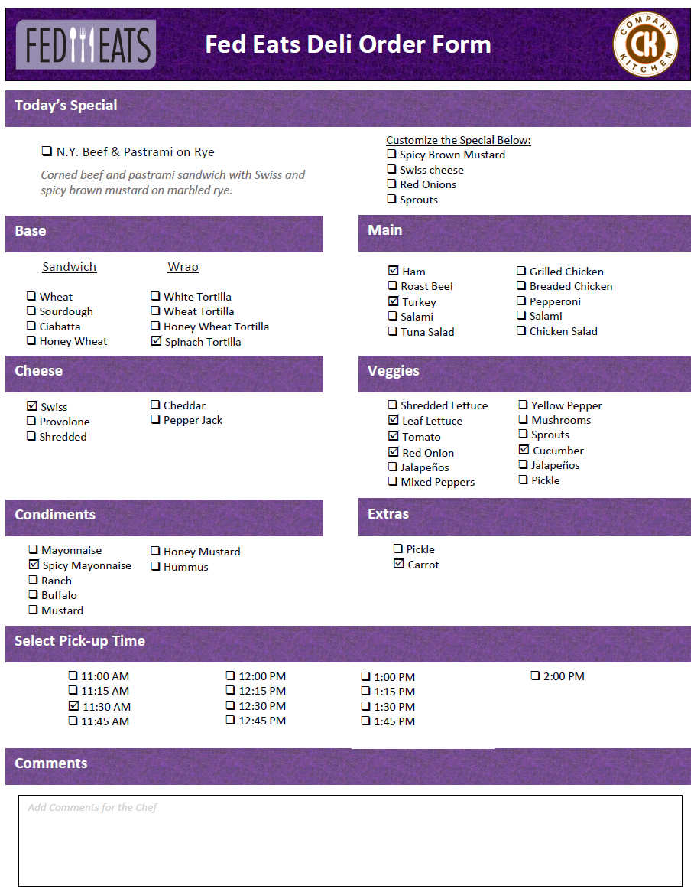
Fed Eats Order Form
Notes:
-julon

Slide 4
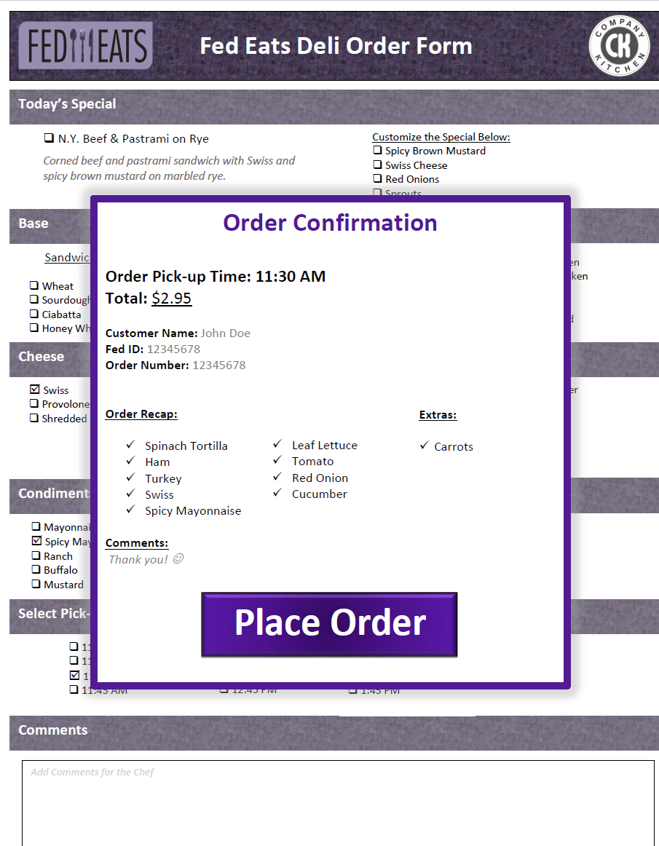
Fed Eats Order Form
Notes:
-julon

Slide 5
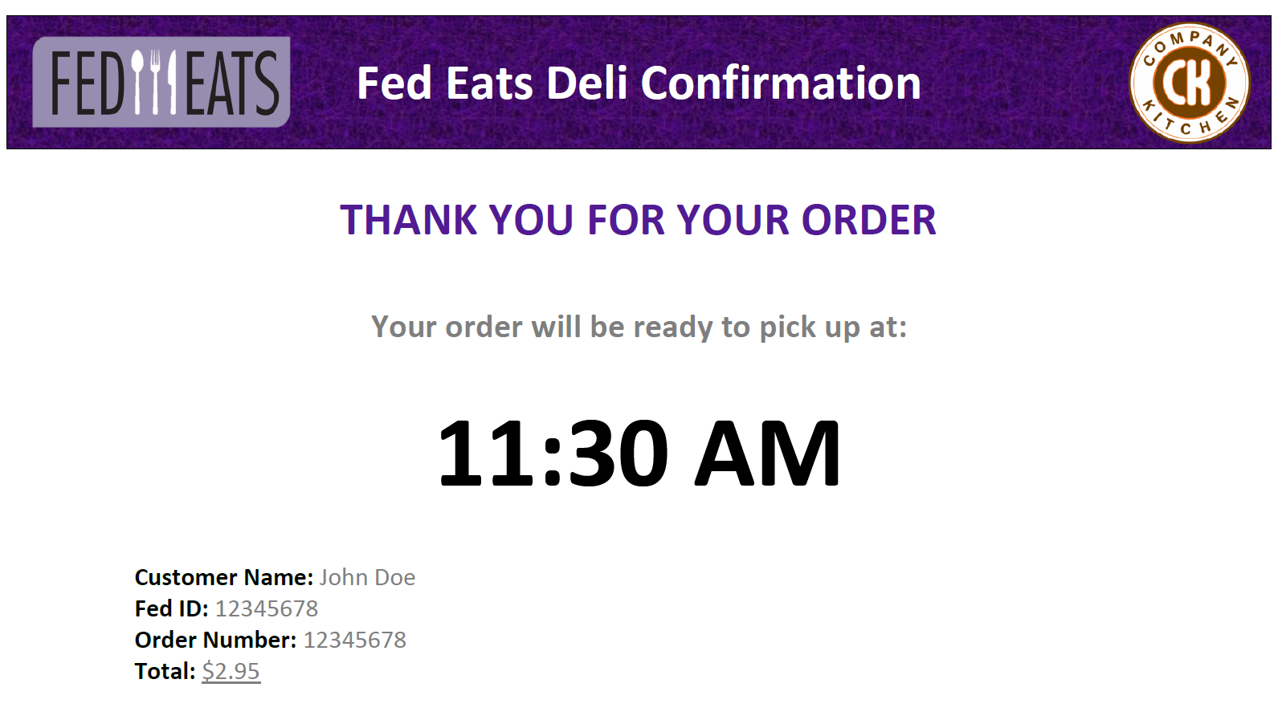
Fed Eats Email Confirmation
Notes:
-julon

